Slide 1

SMASHING THE ATOM
Extraordinary String Based Attacks
Tarjei Mandt
RECON 2012
Notes:
Photo credit: origin unknown

Slide 2
About Me
Security Researcher at Azimuth Security
Past presentations
Heaps of Doom (/w Chris Valasek)
Kernel Attacks Through User-Mode Callbacks
Kernel Pool Exploitation on Windows 7
Generally interested in operating system internals and bug finding
Recent focus on embedded platforms

Slide 3
This Talk
A rather unusual Windows bug class
Affects Windows atoms
3 vulnerabilities patched 2 days ago in MS12-041
Allows a non-privileged user to run code in the context of a privileged process
E.g. the Windows login manager (winlogon)
No need to run arbitrary code in Ring 0
DEP/ASLR? SMEP? No problem!

Slide 4
Previous Work
Atoms briefly mentioned in Windows sandboxing literature
Stephen A. Ridley – Escaping the Sandbox
Tom Keetch – Practical Sandboxing on Windows
Getadmin exploit (1997)
Exploited unchecked pointer in NtAddAtom
API issue – not specific to atom misuse
Notes:
http://en.wikipedia.org/wiki/GetAdmin

Slide 5
Outline
Atoms
Vulnerabilities
Attack Vectors
Exploitation
Windows 8
Conclusion

Slide 6
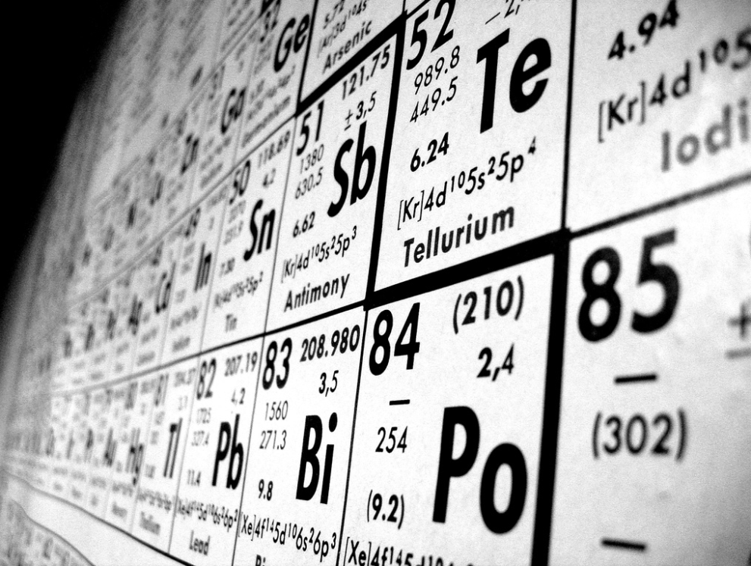
Atoms
Smashing the Atom
Notes:
Photo credit: http://uttim.deviantart.com/art/periodic-table-12797720

Slide 7
Atoms
A Windows data type used to store strings and integers
Referenced using 16-bit values
Stored in a hash table known as an atom table
Generally used to share information between processes
Initially designed to support Dynamic Data Exchange (DDE)
Also used by the operating system

Slide 8
Atom Tables
Defined in the local (application) or global (system) scope
Application defined tables are fully managed in user-mode
System defined tables are managed by the kernel
Callouts to win32k where necessary
Two common system tables
Global And User Atom Tables

Slide 9
Local Atom Table
Defined per application
Table initialization handled transparently to applications
Exposed through an own set of APIs (kernel32)
AddAtom, DeleteAtom, FindAtom, …
Actual implementation in runtime library (NTDLL)
Notes:
InitAtomTable overrides the default number of buckets for the hash table.

Slide 10
Global Atom Table
Defined per window station
win32k!CreateGlobalAtomTable
Accessible to any application in the same window station by default
Can also be job specific if global atoms UI restrictions are enabled
Exposed through an own set of APIs prefixed “Global”
GlobalAddAtom, GlobalDeleteAtom, …
Notes:
SetInformationJobObject (JOB_OBJECT_UILIMIT_GLOBALATOMS)

Slide 11
Global Atom Table (DDE)
Window Station
Global Atom Table
Registers conversation topic string atom
Client Process
Server Process
Client Window
Server Window
Atom
Sends message with topic atom
Uses the atom to look up the topic string
Notes:
http://msdn.microsoft.com/en-us/library/windows/desktop/ms648774(v=vs.85).aspx#_win32_Application.2c_.Topic.2c_.and_Item_Names

Slide 12
User Atom Table
Defined per session
win32k!UserRtlCreateAtomTable
Holds data used by the User subsystem
Window class names
Clipboard format names , …
Not exposed to user applications directly
However, some APIs allow values to be inserted and queried
RegisterWindowMessage

Slide 13
Atom Table Interaction
AddAtom
GlobalAddAtom
User-Mode
InternalAddAtom
NTDLL
RtlAddAtomToAtomTable
KERNEL32
User Subsystem
WIN32K
NTOSKRNL
Kernel-Mode
NtAddAtom
UserGlobalAtomTableCallout
RtlAddAtomToAtomTable
UserAddAtom
Windows 7 SP1

Slide 14
Atom Types
Two types of atoms
Strings and integers
Both types are managed by the same atom table
Defined with separate atom value ranges
No type information needed
Both types are handled using the same APIs

Slide 15
String Atoms
Registered upon passing a string to RtlAddAtomToAtomTable
Assigned an atom value in the range 0xC001 through 0xFFFF
Subsequently used to look up the string
Limits the string size to 255 bytes
Reference counted to keep track of use
Example: Window class names

Slide 16
Integer Atoms
Integer values map directly to the atom value
Never actually stored in the atom table
Defined in the range 1 to 0xBFFF
Only stores decimal values up to 49151
Only registered for the sake of consistency
Example: Standard clipboard formats
Notes:
String: A hash (#) followed by the decimal digits
Integer: 16-bit integer value

Slide 17
Atom Table Creation
Created using RtlCreateAtomTable
Initialized with an integer representing the number of hash buckets (default 37)
A string atom is inserted into a bucket based on its string hash
Used for efficient lookup of string atoms
The atom table itself is defined by the RTL_ATOM_TABLE structure

Slide 18
Atom Table Structure
typedef struct _RTL_ATOM_TABLE
{
/*0x000*/ ULONG32 Signature;
/*0x004*/ struct _RTL_CRITICAL_SECTION CriticalSection;
/*0x01C*/ struct _RTL_HANDLE_TABLE RtlHandleTable;
/*0x03C*/ ULONG32 NumberOfBuckets;
/*0x040*/ struct _RTL_ATOM_TABLE_ENTRY* Buckets[1];
} RTL_ATOM_TABLE, *PRTL_ATOM_TABLE;
Windows 7 SP1 (x86)
Notes:
A separate handle table is used in the process of assigning atom values.

Slide 19
Atom Table Entries
Each string atom is represented by an RTL_ATOM_TABLE_ENTRY structure
Defines the atom value and string
Reference counted to keep track of string (atom) use
Incremented whenever an identical string is added to the atom table
Flags to indicate whether an atom has been pinned

Slide 20
Atom Table Entry Structure
typedef struct _RTL_ATOM_TABLE_ENTRY
{
/*0x000*/ struct _RTL_ATOM_TABLE_ENTRY* HashLink;
/*0x004*/ UINT16 HandleIndex;
/*0x006*/ UINT16 Atom;
/*0x008*/ UINT16 ReferenceCount;
/*0x00A*/ UINT8 Flags;
/*0x00B*/ UINT8 NameLength;
/*0x00C*/ WCHAR Name[1];
} RTL_ATOM_TABLE_ENTRY, *PRTL_ATOM_TABLE_ENTRY;
For handling string hash collisions
Used to generate atom values
Track atom use
Windows 7 SP1 (x86)

Slide 21
Atom Pinning
If the reference count of an atom overflows, the atom is pinned
Indicated by the RTL_ATOM_PINNED (1) flag
A pinned atom is not freed until its atom table is destroyed
E.g. upon destroying a window station or logging out a user
Windows also supports on-demand pinning
RtlPinAtomInAtomTable
Prevents atoms from being deliberately deleted

Slide 22
Atom Value Assignment
Atom tables use a separate handle table for string atom value assignment
Retrieved using ExCreateHandle
Attempts to use a recently freed handle to optimize lookup
Otherwise performs exhaustive search
Actual atom value is obtained by OR’ing the handle index with MAXINTATOM
Atom = ( Handle >> 2 ) | 0xC000

Slide 23
System Atom Table Access
System atom tables are generally available to all user processes
Designed for sharing information
In a sandbox, we want to restrict access in the less privileged components
Prevent leaking of (sensitive) information
Prevent deletion of atoms used by other (e.g. more privileged) applications

Slide 24
Global Atom Table Access
Access can be restricted using job object UI restrictions
JOB_OBJECT_UILIMIT_GLOBALATOMS
When set, Windows creates a separate atom table and associates it with the job object
The process of choosing the correct atom table is handled in win32k!UserGlobalAtomTableCallout
Checks the global atoms UI restriction flag by calling nt!PsGetJobUIRestrictionsClass
Notes:
In Windows 8, callouts to win32k from ntoskrnl are streamlined into a single W32CalloutDispatch function.

Slide 25
User Atom Table Access
In Windows 7, there’s no practical isolation of the user atom table
More on Windows 8 later
Accessible to any process running in the same session
E.g. using APIs which (indirectly) operate on it
A process can query the values of any user atom using GetClipboardFormatName
No distinction made between clipboard format strings and other user atom strings

Slide 26
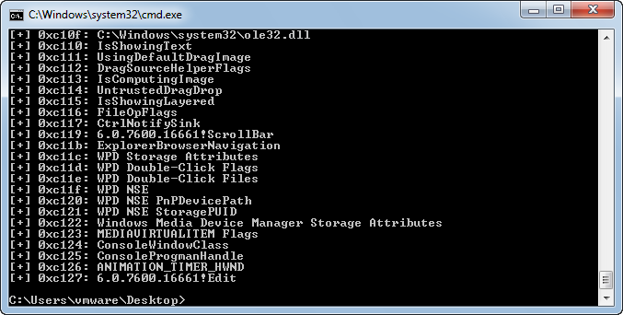
Enumerating User Atoms
Notes:
Also check out: http://code.google.com/p/atom-table-monitor/

Slide 27

Vulnerabilities
Smashing the Atom
Notes:
Photo credit: unknown origin

Slide 28
Atom Handling Vulnerabilities
3 separate vulnerabilities in string atom handling
Register Class Name Handling Vulnerability
Set Class Name Handling Vulnerability
Clipboard Format Name Handling Vulnerability
Addressed in MS12-041
http://technet.microsoft.com/en-us/security/bulletin/ms12-041
Allows an attacker to take control over system managed string atoms
We discuss the implications of this later

Slide 29
Window Class
An application describes a window’s attributes using a window class
Defined by the WNDCLASS(EX) structure
lpszClassName sets the class name
Can either be a string or an atom
Win32k differs between the two internally by looking at the high 16-bits
If only lower 16-bits are set, it is handled as an atom

Slide 30
Class Name String Atom
If a string is provided, win32k converts the string into an atom
Handled by win32k!UserAddAtom
Atom value stored in the win32k managed class data structure (win32k!tagCLS)
If an atom is provided, the function simply copies its value to the class data structure
No atom validation or retaining of reference

Slide 31
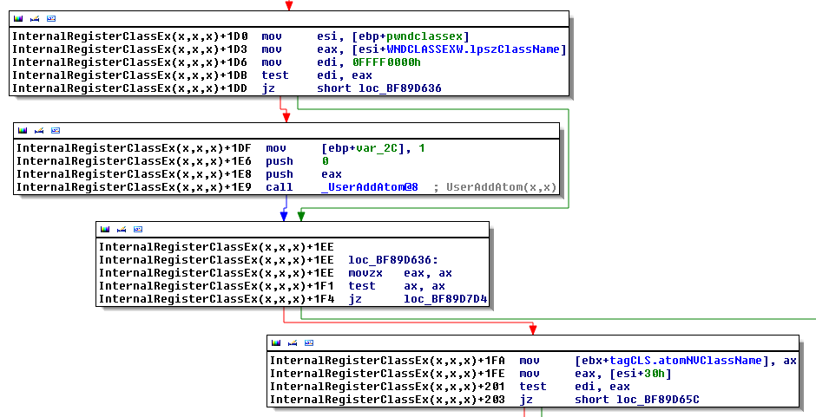
CVE-2012-1864
No reference acquired when providing an atom
Atom stored
Windows 7 SP1 (x86)

Slide 32
CVE-2012-1864
When a class is unregistered, win32k!DestroyClass releases the atom reference
Even when no reference was acquired previously
An attacker could register a class using an atom of a more privileged application
Could free and reregister the atom with a different string

Slide 33
Version Prefixed Class Name
Since Windows XP, class objects define two class name atoms
atomClassName
atomNVClassName
The former defines the base class name
Fixed once registered
The latter prefixes the name with version specific information
6.0.7600.16661!ScrollBar
Allows classes of the same name, but of different versions to be styled differently
Notes:
ScrollBar class example: 6.0.7600.16661!ScrollBar

Slide 34
Updating Class Name Atom
An application can update the version prefixed name of a registered class
SetClassLongPtr using the GCW_ATOM (0xFFFFFFE0) index
Internally, win32k looks up the index (adjusted) in an offset table
Finds the offset to the atom value in the class object structure
In setting or replacing the version prefixed class name atom, no validation or referencing is performed

Slide 35
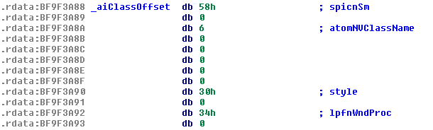
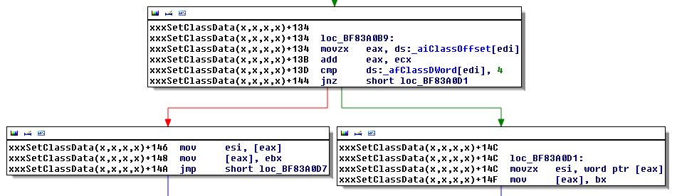
CVE-2012-1865
Offset to version prefixed class name in the class data structure
Replaces value without validation and acquiring or releasing references
Windows 7 SP1 (x86)

Slide 36
Clipboard Formats
Windows uses atoms to uniquely identify each clipboard format type
Applications can also register their own clipboard formats
user32!RegisterClipboardFormat
Registers the atom for the user provided format name string in the user atom table
user32!SetClipboardData
Sets clipboard data of the particular type using the provided atom value

Slide 37
InternalSetClipboardData
Handles SetClipboardData requests
Calls win32k!UserGetAtomName and win32k!UserAddAtom if the provided atom is present
Properly verifies and references the string atom
If the atom is not present, the function still saves the data using the (invalid) atom
Considers the atom to be a default type (integer)
Fails to check if the atom is really an integer atom (i.e. below 0xC000)

Slide 38
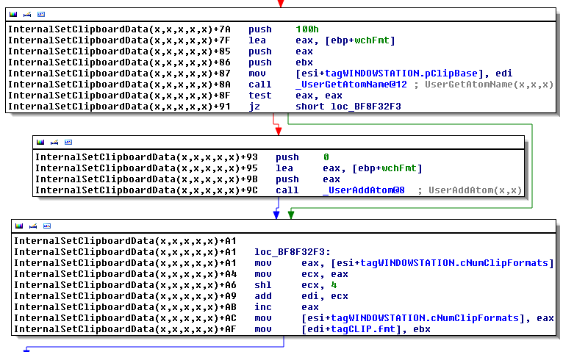
CVE-2012-1866
References atom if string is present in the user atom table
Considers the atom to be valid, regardless of type
Windows 7 SP1 (x86)

Slide 39
Attack Vectors
Smashing the Atom

Slide 40
Enumerating Attack Vectors
Look at how (string) atoms are used by the system
Registered window messages
Clipboard format names
Window class names
Cursor module paths
Hook module paths
Evaluate how user input may affect string atom operations
Notes:
E.g. cross reference atom functions

Slide 41
Registered Window Messages
An application can register new window messages
RegisterWindowMessage
Stored as a string atom in the user atom table
Typically used when messaging between two cooperating applications
If both register the same string, they receive the same message value

Slide 42
Registered Window Messages
Windows does not pin the string atom for the registered message
An attacker may potentially free window message atoms registered by applications
Can cause desynchronization between two applications sending private messages
E.g. by freeing and re-registering messages in reverse-order

Slide 43
Clipboard Format Names
Applications can register their own clipboard formats
RegisterClipboardFormat
Identified as string atoms in the user atom table
These atoms are not pinned, hence can be freed by an attacker
However, clipboard data handling between privilege levels is subject to UIPI
List of exempt formats only contain standard (integer) clipboard formats
Notes:
CF_BITMAP (2), CF_DIB (8), CF_TEXT (1)

Slide 44
Window Class Names
Names of window classes are stored in the user atom table
Atom used by the class object to look up the class name string
Windows does not pin the string atoms of non-system class objects
An attacker could free the atom used by the system to identify class objects
Re-registering the string could cause lookups to resolve to the wrong object
Notes:
System class names are processed (and pinned) in SetupClassAtoms

Slide 45
Cursor Module Names
Windows stores the module path of a loaded cursor as a string atom
atomModName field of the cursor object
Used to determine if a cursor has already been loaded
win32k!_FindExistingCursorIcon
Windows does not pin this atom
An attacker could potentially free its value
Minimal security impact

Slide 46
Hook Module Paths
Windows allows external modules to be used when setting windows hooks
SetWindowsHookEx
SetWinEventHook
RegisterUserApiHook
The module path is stored as a string atom in the user atom table
Atom value stored at an index in the global aatomSysLoaded array

Slide 47
Hook Module String Atoms
Kernel Mode
aatomSysLoaded
Atom
…
…
User Atom Table
Hook Object
Event Hook Object
gihmodUserApiHook
ihmod
ihmod
aatomSysLoaded array index
SetWindowsHook
SetWinEventHook
RegisterUserApiHook

Slide 48
Hook Module Loading
Windows looks up the string atom upon loading an external module hook
Invokes a user-mode callback and passes the string to LoadLibrary
An attacker who frees any such atom could possibly inject arbitrary modules
Hooks play an integral part in Windows in providing application theming
Relies on the user api hook

Slide 49
User Api Hook
Special hooking mechanism introduced to support Windows themes
RegisterUserApiHook
Can only be registered by privileged processes
Requires the TCB privilege
Caller must be running as SYSTEM
Allows Windows to load a theme client module into every GUI application

Slide 50

Exploitation
Smashing the Atom
Notes:
Photo credit: origin unknown

Slide 51
Theme Subsystem
Introduced in Windows XP
Extended in Vista to support desktop composition (DWM)
Hooks into USER32 in order to customize non-client region metrics
Loads an instance of uxtheme.dll into every Windows application
Uses the user api hook registered by winlogon

Slide 52
Theme Server
Manages the theme subsystem
Runs in a service host process
Registers //ThemeApiPort
Keeps track of the Windows theme configuration for all running sessions
Each GUI (themed) process keeps an active connection with the theme server
Used to retrieve updated theme configurations
Notes:
0x31B (WM_THEMECHANGEDTRIGGER) broadcast to processes in order to request theme configuration update
Calls CThemeManagerSessionData::CThemeManagerSessionData to store data for each session
Winlogon broadcasts a message (0x31B) to inform applications that the theme needs update

Slide 53
Theme Api Port Connections
kd> !alpc /lpc 8701a458
8701a458('ThemeApiPort') 1, 10 connections
85a17ae0 0 -> 85e53038 0 853c3790('winlogon.exe')
872802f8 0 -> 863df540 0 853d8540('winlogon.exe')
85289f00 0 -> 853e3038 0 853c3790('winlogon.exe')
86464d18 0 -> 8538a928 0 853d8540('winlogon.exe')
85be9038 0 -> 8533c2e0 0 853ea5c0('mmc.exe')
87257980 0 -> 86fd6458 0 85e63030('explorer.exe')
871fd038 0 -> 86f3db98 0 85dfc8a0('dwm.exe')
85a53368 0 -> 8534f298 0 852eb030('explorer.exe')
871c76a0 0 -> 8659ef00 0 852aa030('calc.exe')
872bc8f8 0 -> 85e6b370 0 853a4388('procexp.exe')

Slide 54
Theme Session Initialization
On each new session, Winlogon calls UXINIT to interface with the Theme Server
Acts as the theme server client
Sends a ThemeApiConnectionRequest packet to //ThemeApiPort over ALPC
Once connected, Winlogon registers a set of callbacks
CThemeServerClient::SessionCreate()
Allows the theme server to load themes and install and remove theme hooks

Slide 55
Theme Hooks Installation
For installing hooks, the theme server service injects a thread into Winlogon
UXINIT!Remote_ThemeHooksInstall
Winlogon (from UXINIT) subsequently calls RegisterUserApiHook
Takes a structure defining the library to load and the function (export) to execute
Library: %SystemRoot%/System32/uxtheme.dll
Function: ThemeInitApiHook
Notes:
Note that the way theme hooks are installed have changed on Windows 8.

Slide 56
Ux Theme Architecture
Registers the User Api Hook
Session 0
Winlogon
Service Host
Informs winlogon about theme changes
UXINIT
Theme Service
ThemeApiPort
Request applications (via message broadcast) to retrieve new theme configuration
Process
Windows 7 SP1
Loaded on demand by the USER subsystem
UXTHEME
Notes:
User Experience Theme Architecture on Windows 7

Slide 57
RegisterUserApiHook
Called by winlogon (UXINIT) to register the user api hook
NtUserRegisterUserApiHook
Registers a string atom for the module path in the user atom table
Atom stored in win32k!aatomSysLoaded array
Array index stored in win32k!gihmodUserApiHook
Notes:
Calls into win32k to perform the actual job

Slide 58
RegisterUserApiHook
typedef struct tagUSERAPIHOOKINIT
{
unsigned long cbSize;
wchar_t * lpszLibFileName;
wchar_t * lpszLibFunctionName;
wchar_t * lpszLibFileNameWOW;
wchar_t * lpszLibFunctionNameWOW;
} USERAPIHOOKINIT;
BOOL
WINAPI
RegisterUserApiHook(USERAPIHOOKINIT * ApiHookInit);

Slide 59
xxxLoadUserApiHook
Retrieves the value of the UAH string atom held by aatomSysLoaded
Module (uxtheme.dll) path
Calls win32k!ClientLoadLibrary to load the module in a user-mode callback
Client side calls user32!InitUserApiHook which hooks several user-mode functions
Subsequently called by USER32 to theme various aspects of the user interface
Notes:
Calls ThemeInitApiHook
Loads the module associated with the user api hook

Slide 60
UxTheme Loading
Kernel Mode
ClientLoadLibrary
xxxLoadUserApiHook
xxxRealDefWindowProc
xxxDefWindowProc
xxxCreateWindowEx
User Mode
(Process)
USER32
UXTHEME

Slide 61
Leveraging UxTheme
Windows does not pin the string atom of the UxTheme library path
An attacker could potentially free the atom and take control of the string
Atoms values used to perform lookups, i.e. no use-after-free of pointer values
May cause subsequent processes to load the module of the specified string

Slide 62
Plan of Attack
Invoke an arbitrary module into a more privileged process
E.g. running as SYSTEM
Requirements
Spawn a new (privileged) process
Running in the same session
Must invoke the USER subsystem (i.e. load user32.dll)

Slide 63
System Processes
Two SYSTEM processes in a typical user session
Client-Server Runtime SubSystem (CSRSS)
Windows Login Manager (winlogon)
CSRSS manages the Windows subsystem
CSRSS and system worker threads are prevented from loading the user api hook
Checks in win32k!xxxLoadUserApiHook
Notes:
Specific checks (threadinfo TIF_flags) to prevent CSRSS and system worker threads from loading the user api hook.
Note that there are also various other processes that may run as SYSTEM in the user session such as the UAC consent mechanism.

Slide 64
Winlogon and LogonUI
Winlogon spawns a separate LogonUI process
Loads credential providers
Displays the Windows login interface
Started on demand whenever Windows needs to present the login interface
Runs on the Secure Desktop (/winlogon))
Only System processes can run on this desktop
Hence, LogonUI runs as System
Notes:
LogonUI protects winlogon’s address space from bugs in credential providers.

Slide 65
Targeting LogonUI
Demo

Slide 66

Windows 8
Smashing the Atom
Notes:
Photo credit: origin unknown

Slide 67
App Container
A new application security boundary introduced in Windows 8
Not just specific to WinRT / metro applications
Allows more granular access control
Introduces the concept of capabilities
E.g. Internet access, music/picture/video libraries, removable storage, etc.
Has its own namespace

Slide 68
App Container Launch
CreateProcess allows processes to be run in app containers
E.g. used by IE 10 “Enhanced Protected Mode”
Creates a low box token and assigns it to the created process
BasepCreateLowBox
Sets up the namespace directories and Global, Local, and Session symlinks
/Sessions/<num>/AppContainerNamedObjects/<package-sid>
BasepCreateLowBoxObjectDirectories
Notes:
Requires the SECURITY_CAPABILITIES extended proc/thread attribute
Requires the indicated package to be registered in the registry – see kernel32!BasepAppContainerEnvironmentExtension
E.g.: HKEY_CURRENT_USER\Software\Classes\Local Settings\Software\Microsoft\Windows\CurrentVersion\AppContainer\Mappings\S-1-15-2-1-1-1-1-1-1-1
See iertutil.dll (e.g. CreateAppContainerProcessStrW) for how IE10 launches low box tabs.

Slide 69
Low Box Token
The crux of the app container
Basically an extension of the token object (nt!_TOKEN)
TokenFlags defines whether a token is a low box token
#define TOKEN_NOT_LOW 0x2000
#define TOKEN_LOWBOX 0x4000
Created by the kernel using a dedicated system call
NtCreateLowBoxToken
Notes:
http://www.iamraf.net/News/essential-winrt-part-3-contracts-and-activation
The caller specifically grants access to kernel objects using the package id

Slide 70
NtCreateLowBoxToken
Allows applications to arbitrarily create low box tokens
Requires a base token
Must not be impersonating
Cannot already be a low box token
Assigns capabilities (SIDs) to a token
References a set of handles by duplicating them into the system process
Guarantees that objects (i.e. namespace) stay valid for the lifetime of the token
Notes:
Can use NtDuplicateToken to create a new low box token from a low box token (i.e. see KernelBase!BasepCreateTokenFromLowboxToken)
Compatibility SIDs are checked via RtlIsCapabilitySid
System process handle duplication: ZwDuplicateObject + Attributes = 0x200 (can only be done when PreviousMode = 0)

Slide 71
NtCreateLowBoxToken
NTAPI
NTSTATUS
NtCreateLowBoxToken(
OUT HANDLE * LowBoxTokenHandle,
IN HANDLE TokenHandle,
IN ACCESS_MASK DesiredAccess,
IN OBJECT_ATTRIBUTES * ObjectAttributes OPTIONAL,
IN PSID PackageSid,
IN ULONG CapabilityCount OPTIONAL,
IN PSID_AND_ATTRIBUTES Capabilities OPTIONAL,
IN ULONG HandleCount OPTIONAL,
IN HANDLE * Handles OPTIONAL
);

Slide 72
Low Box Number Entry
Each low box token is assigned a low box number entry
Creates a hard link between the token and the package sid
nt!_SEP_LOWBOX_NUMBER_ENTRY
Defines the low box (app container) id
Unique session specific numeric identifier
Retrieved from the session lowbox bitmap (nt!_SESSION_LOWBOX_MAP)
Notes:
See SepSetTokenLowboxNumber

Slide 73
Low Box Number Entry
kd> dt nt!_SEP_LOWBOX_NUMBER_ENTRY
+0x000 HashEntry : _RTL_DYNAMIC_HASH_TABLE_ENTRY
+0x00c ReferenceCount : Uint4B
+0x010 PackageSid : Ptr32 Void
+0x014 LowboxNumber : Uint4B
+0x018 AtomTable : Ptr32 Void
AtomTable points to the global atom table
SeCaptureAtomTableCallout
Hash table used to keep track of package sids assigned a low box number entry
SESSION_LOWBOX_MAP.LowBoxMap.HashTable

Slide 74
Low Box Atoms
Windows 8 introduces low box atoms
Implemented using a new atom table reference structure
Allows atoms to be stored in the same table, while restricting access from other apps
Prevents atoms from being deleted by low box (app container) applications

Slide 75
Atom Reference Structure
Embedded by the atom table entry structure
Creates a link between the atom and the low box id
Flags field indicates whether the atom should be shared globally
#define ATOM_FLAG_GLOBAL 0x2
Can be set using the new AddAtomEx API
kd> dt nt!_RTL_ATOM_TABLE_REFERENCE
+0x000 LowBoxList : _LIST_ENTRY
+0x010 LowBoxID : Uint4B
+0x014 ReferenceCount : Uint2B
+0x016 Flags : Uint2B
Notes:
Note that ReferenceCount is not used in the low box case (see RtlpLookupOrCreateLowBox)
Flag values:
0x1: Pinned
0x2: LowBoxAllow (see RtlpAllowsLowBoxAccess)
0x4: LowBoxInUse (no more refcounting from app)

Slide 76
Atoms in Windows 8
Atom Table
Low box atom string references
Atom Table Entry
Atom Table Reference
Atom Table Reference
Atom Table Reference
App Container ID
App Container ID
Defines whether atoms should be accessible to low box apps

Slide 77
RtlpLookupLowBox
Called when querying, deleting, or pinning an atom
Calls RtlpQueryLowBoxId to determine whether a low box token is active
Returns the atom table entry if
The entry belongs to the current low box id
The entry permits access from low box apps
Flags & ATOM_FLAG_GLOBAL
Can optionally override (set by argument) the entry and always deny low box access
Used by RtlDeleteAtomFromAtomTable
Notes:
PRTL_ATOM_TABLE_REFERENCE RtlpLookupLowBox( IN PRTL_ATOM_TABLE_ENTRY Entry, IN BOOL bDenyLowBox );
Global Atom Table: If an app runs with a low box token, all created atoms are destroyed on process termination (ExRemoveLowBoxAtomReferences)

Slide 78

Demo
run_lowbox
Notes:
Photo credit: Lilyhammer

Slide 79
Conclusion
Smashing the Atom

Slide 80
Developer Advice
Always reference atoms on use
Be cautious about trusting information held by the global atom table
Avoiding it is probably best
Use job objects to restrict global atom table access on untrusted processes
Windows 8: Use the low box token for added security
Intra-table atom access restriction
Notes:
Rogue processes may potentially modify or delete entries in the global atom table.

Slide 81
System Hardening
Not all kernel vulnerabilities involve semantically invalid memory access
Mitigations may be less effective
OS hardening generally helps limit the impact of such vulnerabilities
Code signing (page hashing) can address rogue module injection
Already used by Apple in iOS

Slide 82
Thanks!
Questions
@kernelpool
kernelpool@gmail.com
Greetz
redpantz, aionescu, meder, mdowd, hzon, endrazine, msuiche, taviso, djrbliss, jono, mxatone, cesarcer, beist, ++
REcon

Slide 83
References
http://msdn.microsoft.com/en-us/library/windows/desktop/ms649053(v=vs.85).aspx
http://technet.microsoft.com/en-us/security/bulletin/ms12-041

